Slide 1

Price Prediction in Real Estate : A Comparative Analysis of Machine Learning Models
Group 3:
Abdul Haleem Abdul Salam
Sai Nityamani Sahith Matsa
Kason Richard
Rameen Ridah
Zhenqi Zheng

Slide 2


Who are we? Casa crunchers
PROJECT OBJECTIVE:
Business Problem:
Forecast house prices using advanced machine learning models
Managerial Decisions:
Furnish clients with precise estimates tailored to their unique needs and preferences
Enrich real estate experience for both buyers and sellers

Slide 3

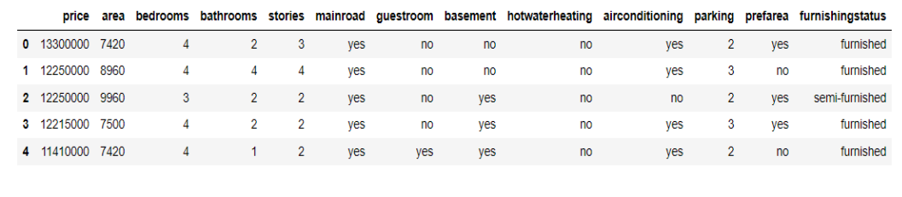
Dataset DESCRIPTION
The ‘Housing.csv’ dataset features 545 observations across 13 features including area, number of bedrooms, and location.

Slide 4
DATA PREPARATION
Initial data exploration was conducted to check for missing or duplicate data. The dataset was found to be clean with no missing values or duplicates, which simplified the pre-processing phase.
Categorical variables were encoded using label encoding to convert them into a numerical format for modelling.

Slide 5
Exploratory Data Analysis
 | Exploratory Data Analysis was conducted to understand the relationships between various features and the target variable (housing prices). Scatter plots were used to visualize the relationship between area and price. Count plots were used to explore the distribution of categorical variables like air conditioning and hot water heating. Box plots analysed key property characteristics such as price, square footage, number of bedrooms, number of bathrooms, number of floors, and parking spaces.

Slide 6
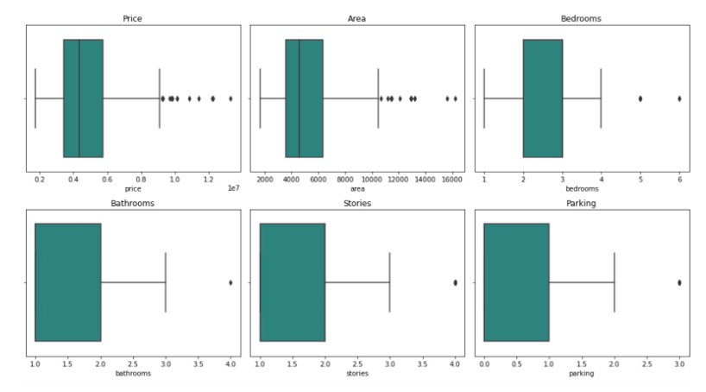

Slide 7




Model Building and Evaluation
The dataset was split into training and testing sets, and feature scaling was performed where necessary. Each model was trained using the training set and evaluated using the testing set.
Evaluation metrics such as mean squared error (MSE) and R-squared (R^2) were used to assess the performance of each model.
Predictions from each model were compared to the actual housing prices to visualize their performance.
Linear Regression, Random Forest Regression, Gradient Boosting Regression, Ridge Regression, Support Vector Regression, Bagging, Boosting

Slide 8

Linear regression
Linear regression attempts to establish a linear relationship between the independent variables (features) and the dependent variable (price). The model was instantiated using The Linear Regression() class from sci-kit-learn and was trained on the training data using the fit() method.
After running this model, we calculated the Mean Squared Error which came out to be 1.771751116594.0410, and the R-squared which was 0.6495. The Linear Regression model shows some predictive capability with a moderate R-squared.
The linear regression prediction shows the model generally follows the overall trend of the actual data. There are discrepancies, especially at points where the actual values peak or drop sharply. These deviations suggest that the linear regression model, despite capturing the general pattern, struggles with extreme values and might not fully account for possible non-linear relationships within the data.

Slide 9
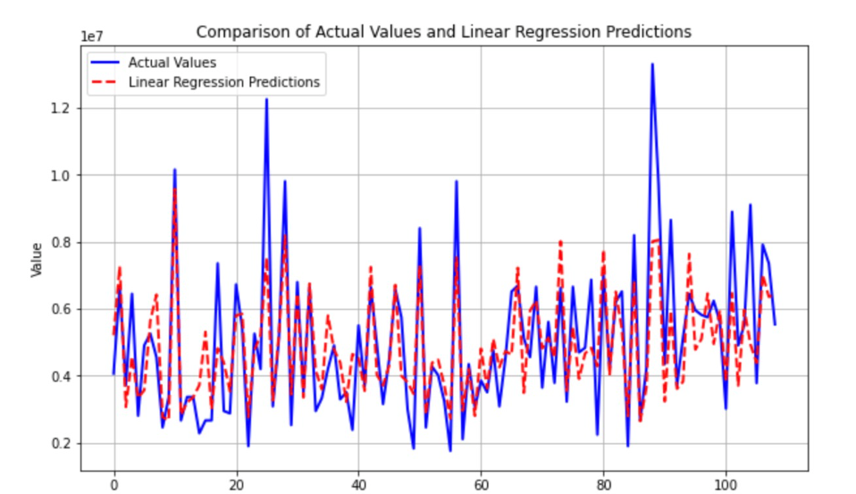

Slide 10
Gradient Boosting Regression
Gradient Boosting Regression operates uniquely when applied to predicting housing prices. It builds upon errors from previous predictions, optimizing its approach through an iterative process.
With an MSE of approximately 1697106834060.5334 and an R-squared of 0.6642, Gradient Boosting demonstrates a robust ability to fit the data better than other models.
The gradient-boosting predictions generally follow the actual data trends closely, although some discrepancies appear at points of rapid value change. This indicates that the model captures the overall patterns well but may struggle with sudden fluctuations in the data.

Slide 11
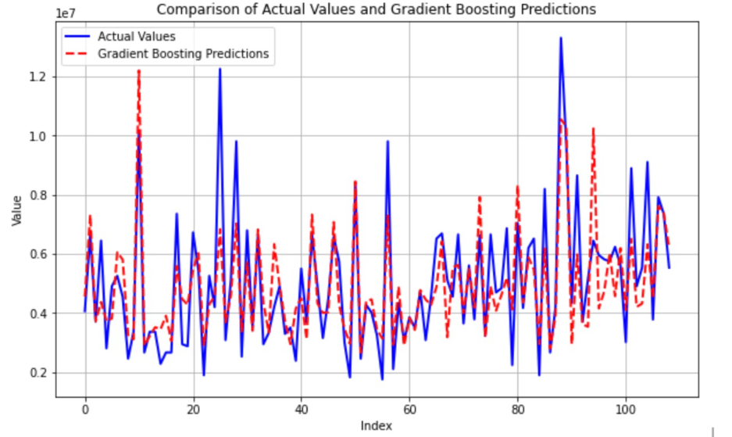

Slide 12
Ridge Regression
Ridge Regression is a linear regression model that includes regularization, which helps prevent overfitting by penalizing large coefficients. It is particularly useful when multicollinearity exists among the predictor variables.
The Mean Squared Error ended up being 1772333186531.0129 and the R-Squared was 0.6494. For Ridge Regression, the R-Squared indicates a relatively good predictive performance. However, the MSE is still relatively high.
The model generally captures the overall trend of the data but may struggle with precision at higher value points.

Slide 13
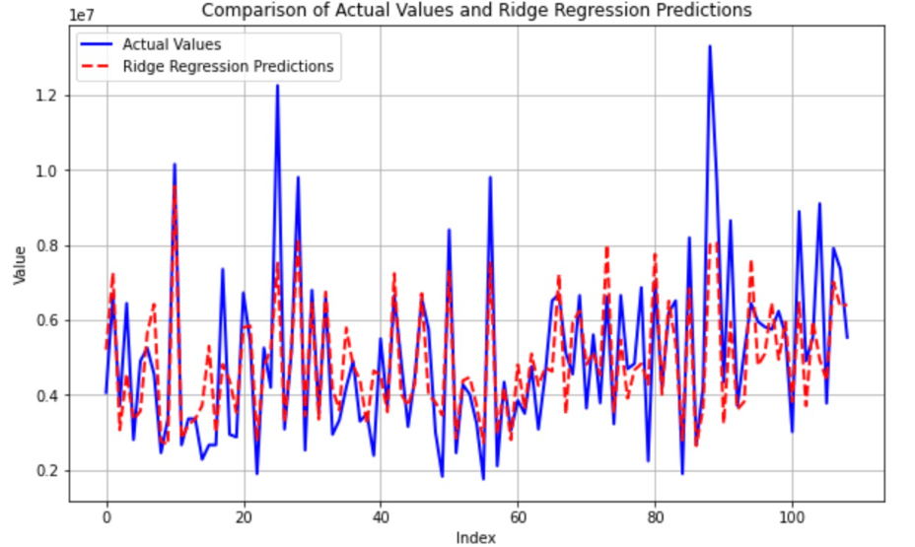

Slide 14
Support Vector Regression
Support Vector Regression (SVR) is a supervised learning algorithm used for regression tasks that constructs a hyperplane or set of hyperplanes in a high-dimensional space to predict the continuous target variable.
The MSE is 4158739800458.7158 and the R-squared is 0.1772. The MSE for this model is high which indicates a large discrepancy between the actual and predicted values. The R-squared for this model is also low which indicates a smaller proportion of the variation of the dependent variable explained by the independent variables.
While the model aligns well with the general trends, it may have challenges with precision during more extreme changes in the data.

Slide 15
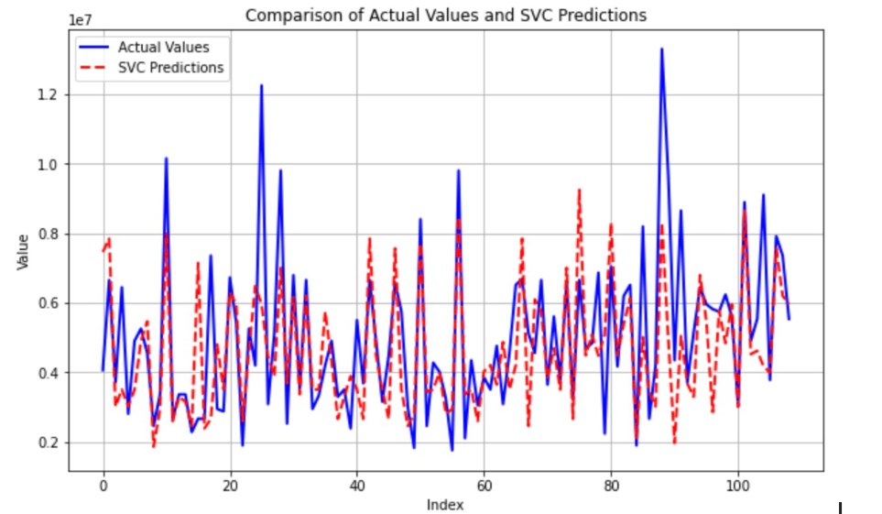

Slide 16
Random Forest Regression
Random Forest Regression can capture complex relationships between features and target variables more effectively compared to a single decision tree.
After training this model, the Mean Squared Error came out to be 1891956925748.2271 and the R-Squared was 0.6257. The R-Squared again indicates that the Random Forest Regression model demonstrates moderate predictive capability and there is still room for improvement indicated by the high MSE.
Random Forest to approximate the actual data points across the range, showing that the predictions often closely follow the actual trends but with some deviations, particularly at higher values or more volatile sections of the data.

Slide 17
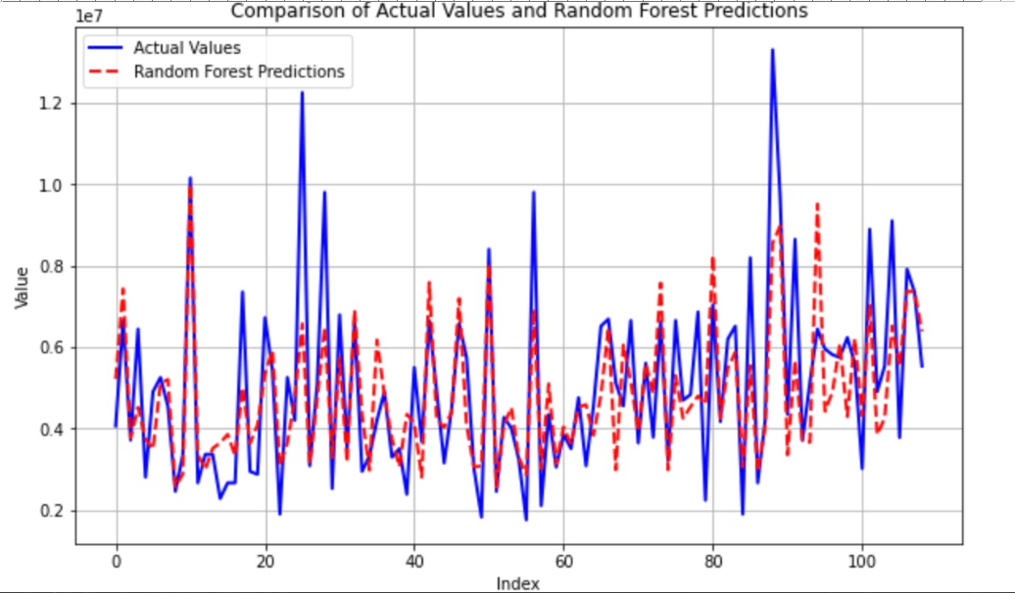

Slide 18
Bagging
Bagging offers a distinct approach to predicting housing prices by utilizing the power of ensemble learning, which stands in contrast to both linear regression and boosting methods.
The bagging method showcased a mean squared error (MSE) of approximately 1.977244607051165e+12 and an R-squared value of 0.6088204. These metrics suggest that while bagging provides a robust predictive capability with better error handling than some other models, it still needs room for optimization to enhance accuracy and model fit.
The Bagging model predictions closely follow the actual data trends, demonstrating a good fit, although there are occasional discrepancies, particularly at data points with sharp peaks or sudden changes.

Slide 19
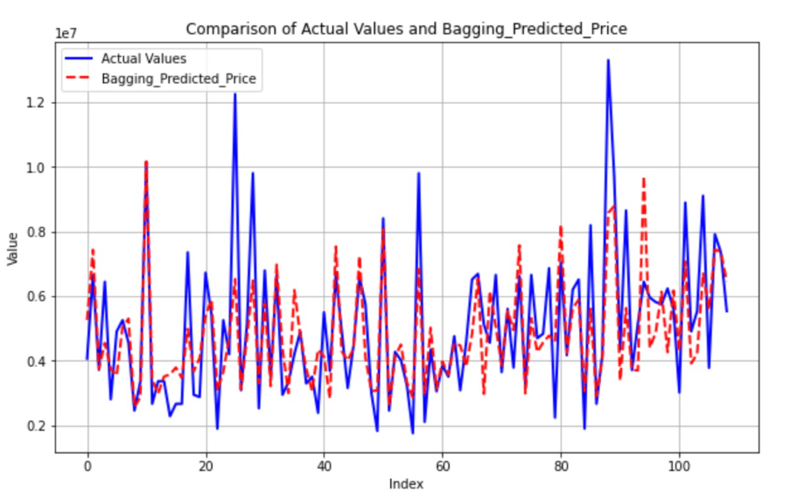

Slide 20
BOOSTING
Boosting is an ensemble learning technique that combines multiple weak learners sequentially to create a strong learner. AdaBoostRegressor, which is a boosting algorithm, is used for regression tasks.
After running the model, the Mean Squared Error came out to be 2077443429238.31 and the R-Squared came out to be 0.5889970209169679. This model shows a high MSE and a lower R-Squared which suggests that the model may not perform well in capturing the variation in the target variable
Gradient Boosting model is generally effective but may occasionally miss the mark on exact peaks or rapid changes in the dataset.

Slide 21
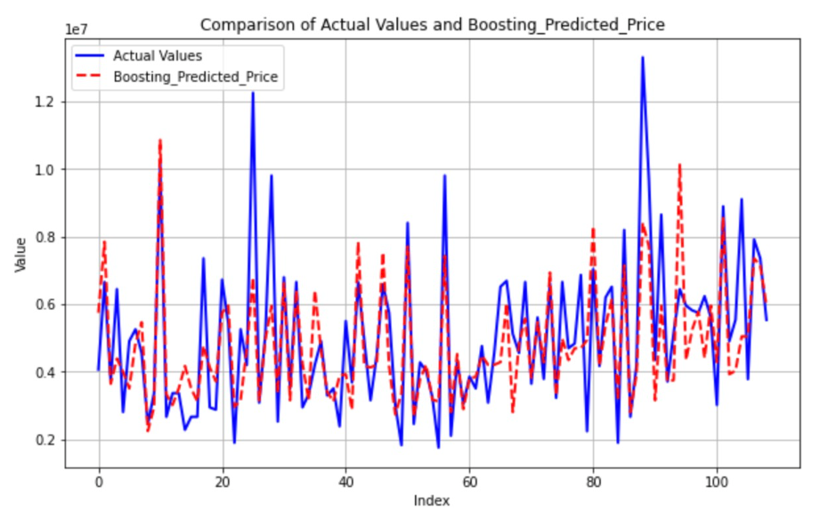

Slide 22

HYPERPARAMETER AND CROSS VALIDATION
We employed hyperparameter tuning using GridSearchCV along with cross-validation to find the best combination of hyperparameters.
The best hyperparameters for the Gradient Boosting Regressor were found to be a learning rate at 0.05, number of estimators at 100, maximum depth at 5, and minimum samples per leaf at 4. The best R-squared score achieved during cross-validation was 0.6307, indicating a good fit of the model to the training data.
The model was evaluated on the test set using an R-squared of 0.6552 and a Mean Squared Error of 1742594144026.4756. Finally, we made predictions on new data using the optimized model.

Slide 23
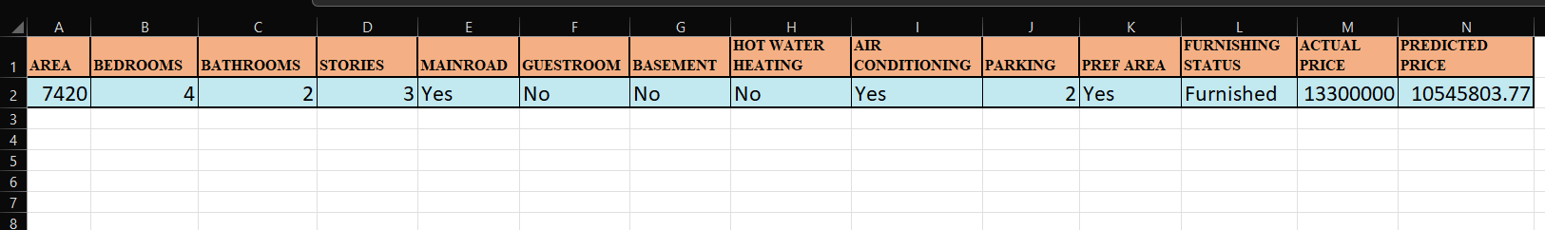

Pre-Hyperparameter Tuning Model Summary

Slide 24
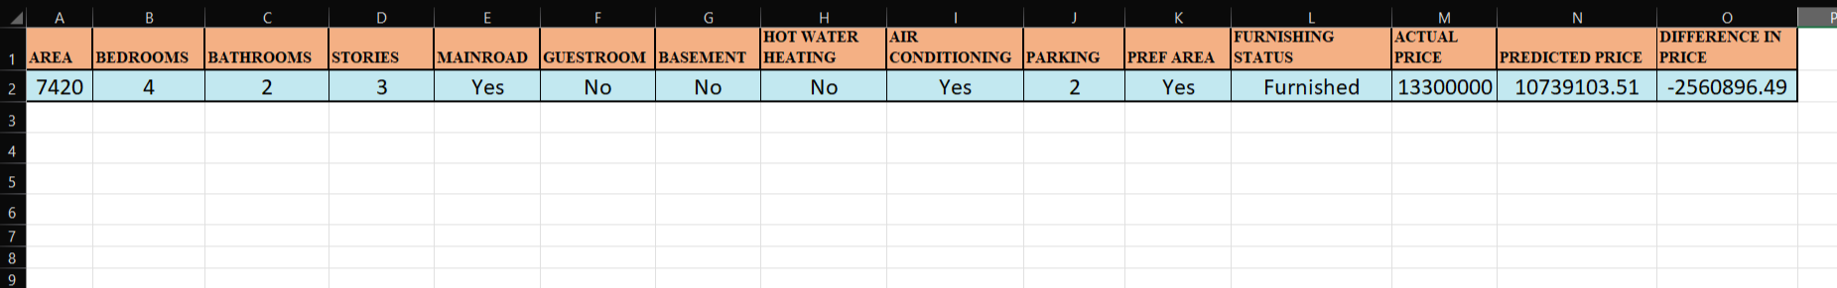
Post-Hyperparameter Tuning Model Performance Summary

Slide 25
Model Implementation in Existing Data(Top 5 Rows)
Data Type | Actual Price ($) | Predicted Price ($) | Difference In Prices ($)
Data 1 | 13,300,000 | 10,679,539 | (2,620,461)
Data 2 | 12,250,000 | 11,142,564 | (1,107,436)
Data 3 | 12,250,000 | 6,825,461 | (5,424,539)
Data 4 | 12,215,000 | 11,290,257 | (924,743)
Data 5 | 11,410,000 | 9,124,701 | (2,285,299)

Slide 26

OBSERVATION
After running our trained model on five data points from the original dataset, we noticed a consistent trend: the original dataset consistently predicted higher house prices compared to our model's predictions. Despite using the same features, our model consistently estimated lower prices for the houses in all five scenarios.
This observation sheds light on potential discrepancies between the original dataset's pricing estimates and our model's predictions. While the original dataset may have provided inflated price estimates, our model's more conservative predictions could reflect a more accurate assessment of house values based on the provided features. This underscores the importance of thorough data analysis and model training to ensure accurate and reliable predictions in real-world applications.

Slide 27

CONCLUSION
This comprehensive study has effectively demonstrated the powerful capabilities of machine learning techniques in the realm of real estate pricing. Among the various models we evaluated, the Gradient Boosting Regression model stood out due to its superior predictive accuracy, achieving the highest R-squared score and the lowest Mean Squared Error. This model, alongside Bagging and Random Forest Regression, represents a significant advancement in our ability to provide accurate and reliable price forecasts.
Our findings not only highlight the potential for these models to assist real estate professionals, homeowners, and policymakers in making more informed decisions but also underscore the importance of continuous model refinement and tuning. Future research could explore the integration of additional predictive factors and the application of more advanced ensemble techniques to further enhance the accuracy and reliability of our predictions.
As we move forward, the iterative improvement of these models will be crucial in adapting to dynamic market conditions and in meeting the nuanced needs of various stakeholders in the real estate market. By pushing the boundaries of predictive analytics, we can hope to achieve not just more accurate pricing strategies but also a deeper understanding of the complex interplay of factors that drive real estate markets.

Slide 28
THANK YOU

